Slide 1
Student Voice, Strong Impact:
APTA Advocacy and Shaping the Future
Notes:
Advocacy plays a crucial role in advancing the physical therapy profession, and your involvement in advocacy throughout your career is essential.
APTA advocates on behalf of the physical therapy profession. Today, we’ll discuss how APTA interacts with the government and why it's important for everyone to participate in advocacy.

Slide 2
What is Advocacy?
Notes:
While advocacy can have many meanings, APTA advocacy refers to the way the physical therapy community comes together to pass laws that will positively affect the future of the profession.

Slide 3
Advocacy Wins and Role of our Advocates
Department of Defense primary care
State wins in direct access and prior authorization
Medicare Physician Fee Schedule
  Plan of care certification
  PTA supervision
Build relationships with lawmakers and regulators
Raise voices with Congress
Send regulatory comments
Notes:
APTA works continuously to protect the future of the physical therapy profession. We’ve had many wins for the profession in 2024 and continue to fight for the profession in 2025.
In January 2024, the Department of Defense announced that physical therapists will now be able to act as the main providers for neuromusculoskeletal care in all DOD settings. This change allows people to see PTs directly without needing a referral. This is a result of efforts by APTA in 2022, which helped make this possible through a law passed in 2023. Although PTs have already been giving care for neuromusculoskeletal problems in the military, this new policy will make sure that PTs can provide care everywhere in the DOD by the end of 2025.
We celebrated two big victories when new changes were made to the 2025 Medicare Physician Fee Schedule rule. First, the rule changed the old requirement for how PTAs are supervised in outpatient settings. Now, they only require general supervision instead of direct supervision. Second, there were changes to the rules about certifying plans of care under Medicare Part B, which will help reduce paperwork.
APTA advocates were critical in our advocacy wins; your voice and your experience is important for legislators and regulators to hear. The thousands of letters, phone calls, social media posts, legislator meetings, fundraisers, and more from APTA advocates were critical in these successes and must continue for future wins.

Slide 4




I’m Just a Bill
Legislative
Congress
Executive
Regulatory
Judicial
Federal courts
Notes:
Congress and the federal government holds significant power over the future of physical therapy. The laws and regulations they create impact payment policies and the scope of practice. Without the physical therapy profession raising our voices, laws could be passed that hurt the profession. This is why it’s so important for you to get involved not only now as a student, but consistently throughout your career.
So how does the federal government work?
How many of you remember high school government class? What do you remember from it?
APTA frequently works with Congress, which is made up of the House of Representatives and the Senate. The House has 435 members, with the number of representatives from each state based on population. The Senate has 100 members, with two senators from each state.
Who represents you? Ask the group to name their representative and senators.
Laws are introduced in both the House and the Senate, and they go to committees for deeper review. These committees debate the bill and hear from experts and stakeholders, like APTA, before making changes or moving it forward.
For physical therapy issues, the most important committees are in the House Energy and Commerce and Ways and Means committees, and in the Senate Finance and Health, Education, Labor, and Pensions committees. Building relationships with lawmakers on these committees is crucial for advancing legislation that benefits the profession. APTA’s lobbying efforts on Capitol Hill help amplify your voice in support of policies that benefit the profession. But to do that, we need strong relationships with key members of Congress and their staff.
But APTA’s work isn’t just with Congress. We also engage with federal agencies like the Department of Health and Human Services (HHS) and the Centers for Medicare and Medicaid Services (CMS). These agencies have a big impact on physical therapy practice, payment policies, and other important areas.

Slide 5
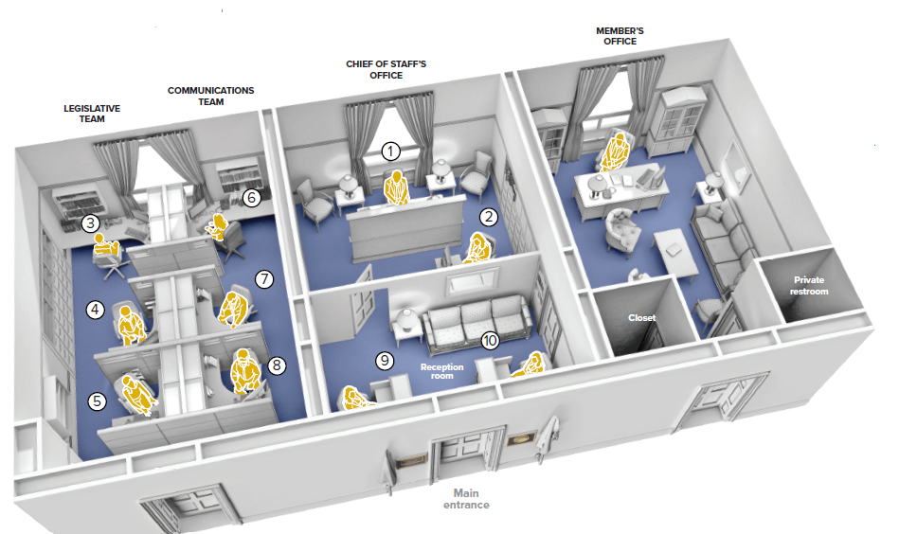
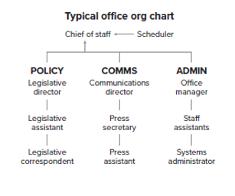
Congressional Office
Notes:
So, how is a congressional office set up? And why is this important to know? Congressional offices generally have three main areas: policy, communications, and administration.
Policy staff, including legislative assistants, focus on specific issues, like healthcare. These are the people you want to connect with because they influence how the member of Congress votes on healthcare issues.
Communications staff handle the press and social media, while administrative staff manage the daily operations of the office. When you call a member of Congress, it’s usually the administrative staff you’ll speak with.
Why do we want you to know how an office is set up? It’s important to know so you may interact with the staff effectively and overall know how your representation is run.
So, what’s the most important thing to say when you meet with a member of Congress or their staff?

Slide 6

Your Voice Matters
Legislators want to hear from you
Sharing your story is impactful
Notes:
Your personal story. Every person in the physical therapy profession has a unique story to tell about how their work impacts patients and the community. Many members of Congress may not fully understand what physical therapy is, so it’s up to us to educate them.
Members of Congress were elected to represent their communities, and they want to hear from you. Sharing your story can show how a proposed law will affect real people in your community, clinic, or school.
Remember, you are the expert on physical therapy. Your voice matters and sharing your experience can help make an impact on the decisions that shape the future of the profession.
But APTA’s work isn’t just with Congress. We also engage with federal agencies like the Department of Health and Human Services (HHS) and the Centers for Medicare and Medicaid Services (CMS). These agencies have a big impact on physical therapy practice, payment policies, and other important areas.

Slide 7
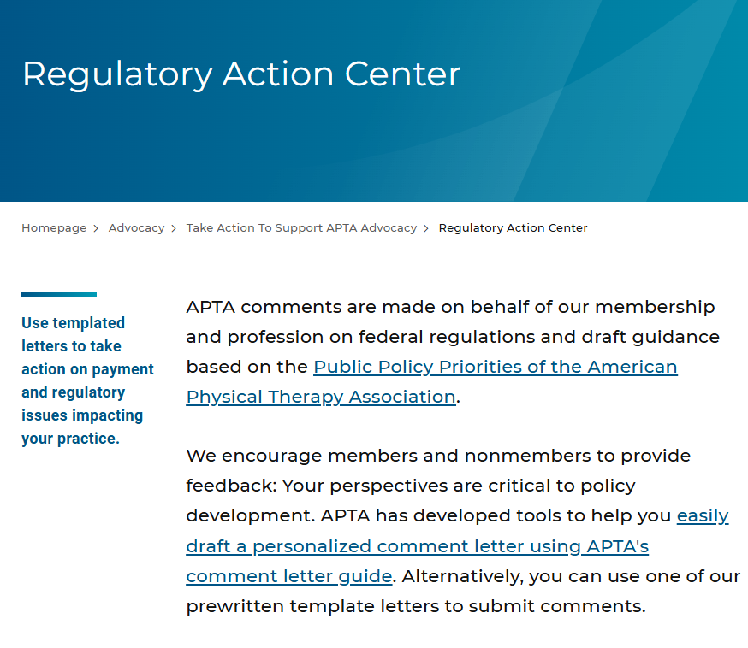
Regulatory Action
Notes:
One way to get involved in advocacy with these agencies is by commenting on proposed rules. When a federal agency suggests a new rule, they go through a process called “notice and comment rulemaking.” This allows the public, including physical therapists, to share their thoughts on how the rule might affect their practice.
APTA has a Regulatory Action Center where you can find out about comment opportunities and use a template to submit your own comments. Adding your personal experience to these comments can help make a stronger case for or against a rule.

Slide 8
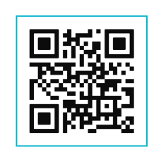
How Can You Get Involved?
Join the APTA Advocacy Network
Legislative Action Center
Patient Action Center
Regulatory Action Center
APTA Advocacy App
Key Contact
Support PTPAC
APTA Capitol Hill Day
  July 14-15
Legislator visits in your area
  Practice
  School
  District office
Community events
Notes:
What ways can APTA members get involved? There are many ways, such as attending events, participating in advocacy campaigns, and meeting with lawmakers directly. APTA regularly organizes opportunities for members to engage with Congress and share their voices.
There are many tools for APTA members to engage with Congress and advocate for the profession.
Join the APTA Advocacy Network
This group is our strength in numbers. Sign up to stay connected and receive important updates.
The Legislative Action Center: This is available only to APTA members and provides pre-written emails and social media posts you can send to your representatives.
The Patient Action Center: Available to both APTA members and non-members, including patients and supporters, with similar tools for outreach.
The Regulatory Action Center: Check out opportunities to engage with regulators and use customizable templates to send comments to federal agencies.
Download the APTA Advocacy App
Available on the App Store or Google Play, this app lets you sign up for the Network, send letters to your members of Congress, view advocacy training videos, and learn about key policy issues.
Become a Key Contact
If you want to form and build relationships with your members of Congress and their staff, this is the program for you. Key Contacts are provided opportunities to meet with their members of Congress in their area and receive frequent advocacy updates and training throughout the year. Reach out to APTA at advocacy@apta.org to join.
Support PTPAC
Get involved by supporting APTA’s political action committee. We’ll have more information on PTPAC in the next slide.
Attend APTA Capitol Hill Day
Held in conjunction with APTA Leadership Congress in 2025, join us July 14-15 in Washington, DC to receive advocacy training and meet with your members of Congress.
Visit or host a legislator
Legislators are frequently back home to meet with their constituents. Invite your members of Congress to tour your program, meet with them in their district office, connect with them at a town hall meeting, schedule a Zoom meeting, or connect with them on social media. There are countless ways to talk about the profession with legislators outside of Washington, DC.
Meet legislators at community events
Keep your eye open for community events where legislators will be present. Use those events as opportunities to talk about physical therapy. Subscribe to your legislators’ newsletters, follow them on social media, read your local newspaper, and be aware of community events to find these opportunities.
However you want to get involved, there is a program for you.

Slide 9
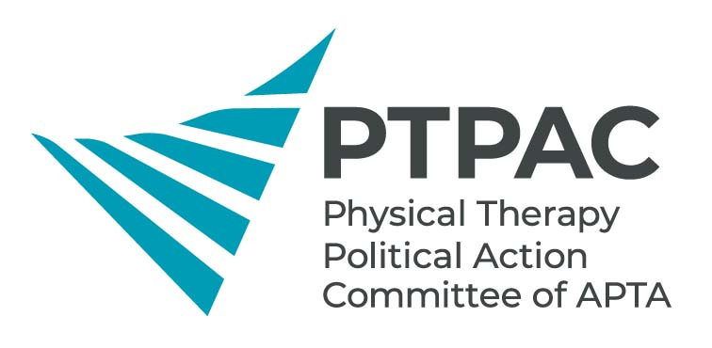
PTPAC
By law, APTA dues cannot go toward PTPAC
Critical meetings with lawmakers
Support PT friendly candidates
Notes:
PTPAC is APTA’s bipartisan political action committee and it relies on voluntary donations from APTA members to help advocate for the profession. By federal election law, APTA dues cannot go toward PTPAC.
For over 50 years, PTPAC has made a difference by directly connecting with legislators and supporting those who champion physical therapy.
PTPAC is bipartisan and supports PT-friendly members of Congress in their election campaigns.
Provides opportunities for APTA members and lobbyists to build relationships and talk directly to members of Congress at fundraisers about issues affecting the profession.
You can support PTPAC by donating $20 and becoming a Student Star. Donors receive a lapel pin and recognition on the PTPAC website. It’s a great way to connect with legislators and candidates who support the profession.
If you want to, you may select a party of your choice when you donate.
Your involvement in advocacy is crucial for the growth and protection of the physical therapy profession. By staying informed, raising your voice, and building relationships with lawmakers, you can help shape the policies that will define the future of physical therapy.
What are some of the issues we work on?

Slide 10
Legislative Issues

Slide 11

2025-2026 APTA Public Policy Priorities
“Road map” for the next two years
Educate members of Congress
Notes:
To guide our advocacy efforts and led by input from APTA members, APTA sets public policy priorities every two years, aligned with the start of a new session of Congress. APTA publishes a document outlining these priorities for Congress and federal regulators.
This document, the 2025-2026 Public Policy Priorities, presents the “big picture” of the role and value of physical therapy in the healthcare system. It highlights how physical therapy can improve outcomes, reduce costs, and transform society. It also lists major policy areas that Congress and the Administration need to address.
The Public Policy Priorities document is primarily aimed at educating U.S. Congress members, Hill staff, and federal agencies about physical therapy. This document is not an exhaustive list of all the policies APTA supports but focuses on key areas for legislative action.

Slide 12
Medicare Payment Reform
    Key component to permanently reforming the Medicare Physician Fee Schedule.
    The MPFS is the only system that does not have an annual update
    Costs have gone up while cuts to payment have been implemented
Notes:
APTA is actively working on Medicare payment reform to stop the year over year cuts the profession faces. One of the key components to permanently reforming the Medicare Physician Fee Schedule, is addressing a crucial gap—the lack of an annual update.
Unlike other systems, the MPFS is the only one that doesn’t undergo an annual adjustment. This means, year after year, healthcare providers face an unstable and unsustainable payment structure.
While the costs of providing care continue to rise, cuts to physician payments have been implemented. The result? Physical therapists are under more financial strain, and patient care could be impacted. It's clear that without a reform of the MPFS, the situation will only continue to worsen.
A permanent solution is needed—one that allows for regular updates to the Medicare Physician Fee Schedule, helping ensure that physical therapists can continue to provide quality care while keeping up with the rising costs.

Slide 13
Pelvic Health Physical Therapy
  Improve awareness of and access to pelvic health physical therapy
  Issue guidance, best practices, and importance or pelvic health physical therapy for postpartum individuals.
Notes:
Pelvic health physical therapy is crucial for postpartum recovery, yet many new mothers lack access or awareness of its benefits. Even some healthcare providers may not recognize its importance.
APTA is working on the reintroduction of a bipartisan bill that aims to raise awareness and improve access to pelvic health services, including physical therapy, for postpartum women on Medicaid and CHIP. It will guide state programs and educate both providers and patients on the importance of pelvic health care. This bill was brought about by APTA advocates and PTPAC!

Slide 14
Locum Tenens
  Prevent Interruptions in Physical Therapy Act (H.R. 1517)
  Locum tenens means “to hold the place or substitute”
  Allows physical therapists temporary absences from clinic (vacation, continuing education, health care needs, etc.)
Notes:
This bill expands locum tenens arrangements for physical therapists under Medicare, allowing qualified replacements during temporary absences due to illness, vacation, continuing education, etc. Locum tenens is Latin meaning “to hold the place of or substitute.”
Currently, locum tenens is only allowed in rural and underserved areas, limiting PTs in private practice from taking necessary leave without interrupting patient care.
The Prevent Interruptions in Physical Therapy Act (H.R. 1517), this legislation would expand locum tenens to all regions, ensuring continuous care and offering more flexibility for physical therapists.

Slide 15
Falls Prevention
  SAFE Act (H.R. 1171)
    Stopping Addiction and Falls for the Elderly Act
  Expand and increase access to falls screening and prevention
    “Welcome to Medicare” visit, or Initial Preventive Physical Examination (IPPE)
    Medicare Annual Wellness visit (AWV)
    Physical therapist can help assess risk factors and develop a plan to address them to help avoid falls.
    May reduce long-term opioid medication use.
Notes:
Every year, falls lead to 3 million ER visits and 1 million hospital stays among older adults. The cost of these falls is staggering—$50 billion in medical expenses annually, with 75% of that covered by Medicare and Medicaid. What’s even more concerning is that if someone falls once, their chances of falling again double.
APTA is advocating for the Stopping Addiction and Falls for the Elderly Act and the bill was introduced in February. This bill aims to make falls screening and prevention more accessible, especially to help reduce the use of opioids, which often follow a fall.
The SAFE Act would add falls screening for individuals who’ve experienced a fall in the past year to Medicare’s Welcome to Medicare visit (IPPE) and Annual Wellness Visit (AWV).

Slide 16
Student Loan Repayment/Community Health Centers
Add PTs as primary health services providers in Community Health Centers (CHCs).
Add PTs to the National Health Service Corps Loan Repayment Program
Notes:
APTA is working on a combination bill to improve access to care for people in rural and underserved areas. One part of the bill aims to reduce the student loan burden for PTs while enabling them to provide critical therapy care in Health Professional Shortage Areas —areas that often face shortages of healthcare providers. HPSAs can be in diverse areas across the United States; from rural areas to big cities.
The NHSC Loan Repayment Program recruits medical providers to work in these underserved regions, offering up to $50,000 in student loan repayments. In exchange, providers commit to working full-time for two years or part-time for four years in a HPSA. Currently, physical therapists aren’t included in the NHSC program, but the legislation we are working on would change that, allowing PTs to treat patients in HPSAs.
Right now, physical therapists working in community health centers must do so under the supervision of a primary care physician, which doesn’t encourage PTs to be on staff. This bill would give CHCs the flexibility to hire PTs directly and bill Medicare and Medicaid for their services—making it easier for patients to access physical therapy.

Slide 17
Regulatory Issues
Notes:
Let’s talk about APTA’s work in the federal regulatory space.

Slide 18





Regulatory Landscape
Health and Human Services
Education
Labor
Defense
Veterans
Notes:
APTA monitors, advocates and communicates with the regulatory bodies. We also educate them about physical therapy and how regulations impact the profession and the patients we serve.
We work with the Department of Health and Human Services, or HHS, which covers Medicare, Medicaid, and much, much more.
The Department of Education oversees special education and student loans.
The Department of Labor covers workplace regulations. APTA monitors OSHA, or the Occupational Safety and Health Administration, assures safe and healthful working conditions by setting and enforcing standards, and by providing training, outreach, education and assistance.
We also monitor the Employee Retirement Income Security Act, or ERISA, a federal law that sets minimum standards for most voluntarily established retirement and health plans in private industry to provide protection for individuals in these plans.
APTA works with the Department of Defense on issues related to TRICARE, a health care program for uniformed service members, retirees, and their families.
The Department of Veterans Affairs is important to physical therapy and we monitor VA programs and administration.

Slide 19
Health and Human Services
Centers for Medicare and Medicaid Services
FDA
Food and Drug Administration
Health Resources and Services Admin
National Institutes of Health
SAMHSA
Substance Abuse and Mental Health Service Administration
NIH
HRSA
CDC
Centers for Disease Control and Prevention
IHS
Indian Health Services
CMS
AHRQ
Agency for Healthcare Research and Quality
Notes:
HHS regulates Medicare and Medicaid but this department also governs the federal Marketplace, which you may know as Obamacare or the Affordable Care Acts plans.
Now, this is so important because half of the US population is covered by those three programs alone—Medicare, Medicaid, and ACA plans. I present these numbers to explain the gravity of our advocacy work with HHS.
Now, there are also many other agencies within HHS that we may work with such as:
The Food and Drug Administration who regulates medical drugs and devices,
HRSA, the Health Resources and Services Administration, whose primary focus is advancing health equity,
And the CDC and the National Institute of Health We look to these agencies for safety recommendations as well as to fund the research that will inform PT practice in the future.
Now, I won't cover every agency on this slide, but this gives you a sense of what we mean when we say health and human services.

Slide 20
Annual Rulemaking
Winter
Medicare Advantage
Affordable Care Act Plans
Spring
Inpatient Rehab
Skilled Nursing
Fall
Summer
Inpatient Hospital
Home Health
Medicare Physician Fee Schedule
Fee Schedule Final Rule
Notes:
In general, the rulemaking process happens on an annual basis. CMS, the centers for Medicare and Medicaid Services, release their proposed rules at around the same time each year. Usually the ‘big’ rules come out in the spring and summertime.
It is important to recognize that the largest rule that we work on each year is the Medicare Physician Fee Schedule, which sets payment rates for all providers in Medicare Part B which pays for outpatient physical therapy services. This is where CMS also makes large changes to the Medicare program each year.
For example, if they decide to cover physical therapy services provided via telehealth, we would find out here. Or if they decide that PTAs can practice under general supervision under Part B, this is where they would propose that change. In other words, this rule is very important to the profession as a whole.
Now it isn’t the only rule APTA monitors, you can basically guarantee that we are going to comment on these other rules as well. Including the annual Medicare Advantage rule that makes changes to how MA plans are administered. Or the skilled nursing and inpatient rehabilitation rules that create standards for both of those settings. Now, while these rules are almost always a guarantee, departments can also decide to propose new rules or release requests for information where they gather input from stakeholders before even proposing a new policy.

Slide 21
Student Advocacy Activities
Notes:
As the future of the physical therapy profession, student involvement in advocacy is vital. APTA offers a variety of programs to empower PT and PTA students to engage in advocacy throughout their careers. Here are some opportunities for students to get involved year-round.

Slide 22
Student Advocacy Programs – Student Advocacy Challenge
Simple ways to get started in advocacy
Programs compete against each other by participating in advocacy activities
Submit activities for credit through APTA website or APTA Advocacy App
January 2025-December 2025
Notes:
Want to get started in APTA advocacy? Participate in the Student Advocacy Challenge and join in advocacy activities that will impact the future of the profession and encourage your participation not only as a student, but throughout your career.
The Student Advocacy Challenge is a year-long competition where PT and PTA students—and their programs—participate in advocacy activities, submitting their efforts for points. The goal is to compete with other schools while making a real impact. Attending the National Advocacy Dinner counts for 10 points per student so be sure to log your individual participation after the presentation.
The winning school will earn a virtual visit from an APTA leader of their choice, a feature article, and year-long recognition on the APTA website.
So, get involved, make your voice heard, and help your program lead the way in advocacy!

Slide 23
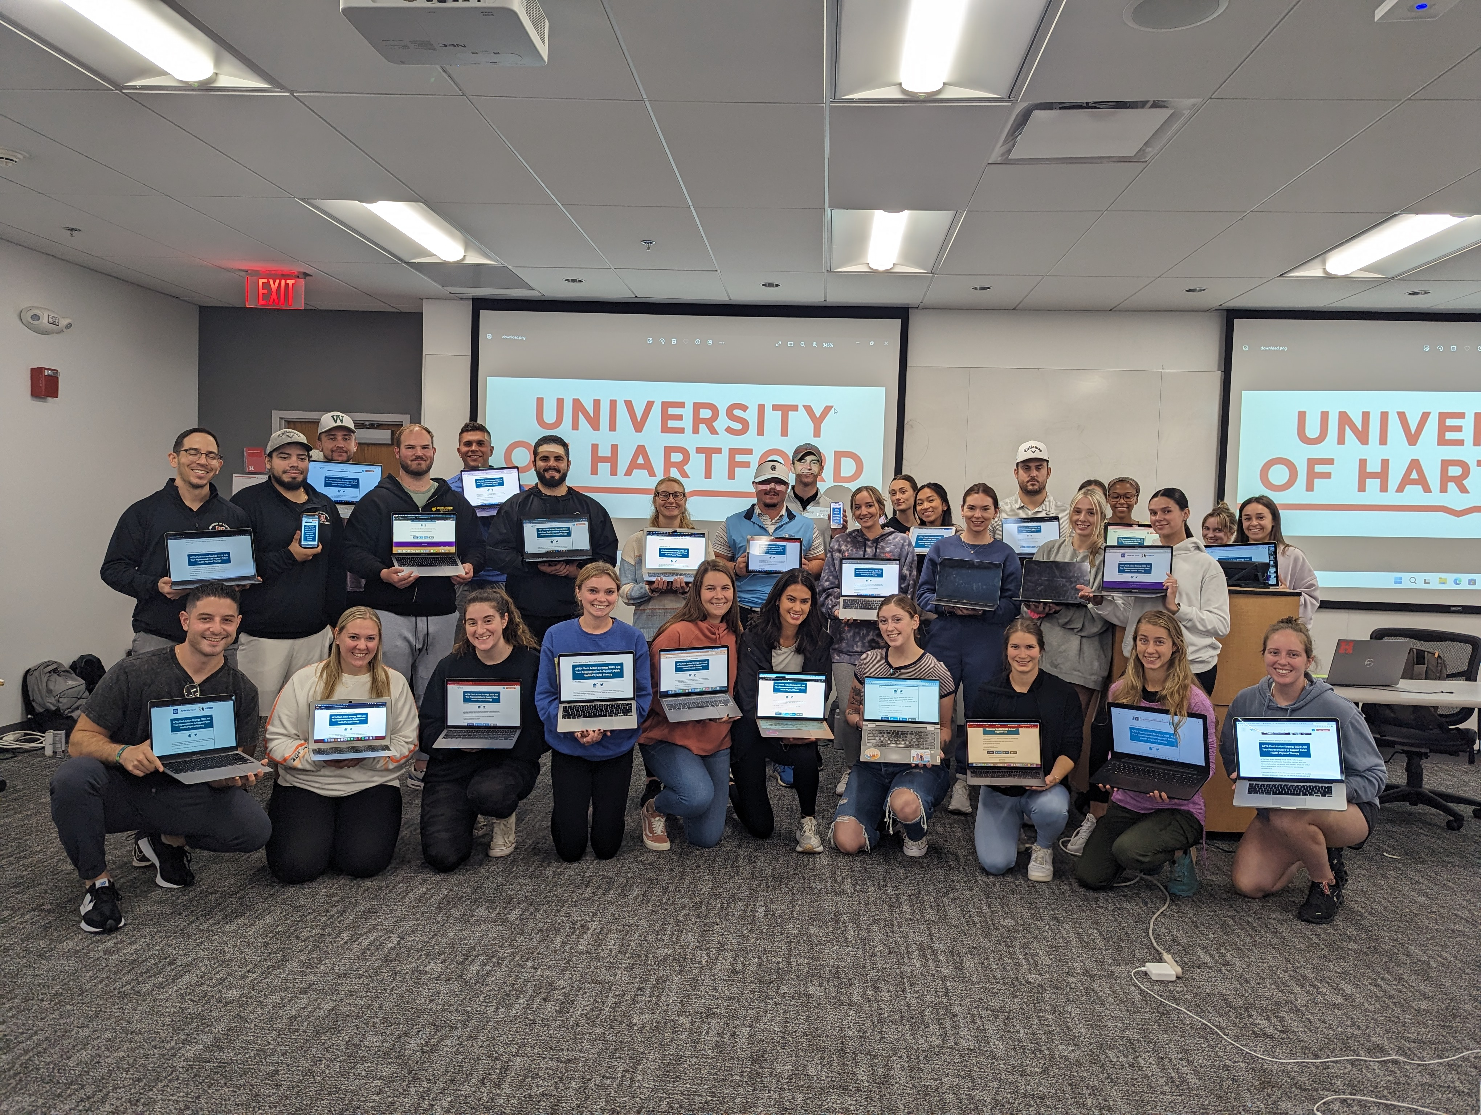
Student Advocacy Programs – Flash Action Strategy
Two-day, student-led social media blitz
Raise awareness on an issue with legislators
Over 90,000 letters to Congress since 2013
September 2025
Notes:
In September, plan to participate in APTA Flash Action Strategy—a two-day, student-led social media blitz held every fall to raise awareness around critical advocacy issues. Since 2013, students have sent over 91,000 letters to Congress! By participating in these programs, you can make a lasting impact on the future of physical therapy while building a career-long commitment to advocacy.

Slide 24
Questions?
advocacy@apta.org
Notes:
If you have questions or want to get involved, please reach out at advocacy@apta.org.

