Slide 1
APTA National Advocacy Dinner 2024
YOUR SCHOOL HERE
Notes:
Welcome to the 2024 National Advocacy Dinner! You are joining PT and PTA students across the country by gathering at this annual event to learn more about advocacy and how you can be a lifelong advocate for the physical therapy profession. Your participation in physical therapy advocacy is crucial in advancing policies that will positively impact the profession. In this presentation, you will learn about some of the issues APTA advocates for and how you can get involved not only now, but throughout your career. As the saying goes, if you aren’t at the table, you’re on the menu.

Slide 2
What is APTA Advocacy?
Notes:
Participating in advocacy is essential to the future and advancement of the physical therapy profession. Laws are made at all levels of government that impact the profession, including how you can practice, how you are paid, how patients are treated, among many other outcomes. If the physical therapy profession doesn’t have a seat at the table where these decisions are being made, laws and regulations may be passed that would harm the profession. We have to both speak up on the issues we work on and educate lawmakers about what physical therapy is and how it impacts people‘s lives.
We’ll talk about how APTA interacts with the government and why it’s important for everyone to raise their voice.

Slide 3
What is APTA Advocacy?
The future of the physical therapy profession is in the hands of lawmakers
Building relationships with legislators
APTA members
APTA lobbying support
Your voice matters
Legislators/policymakers want to hear from you
You are the expert
Education about physical therapy
Notes:
Advocacy can have a lot of different meanings, but for our purpose, it means raising our voices with lawmakers to positively impact and protect the future of the physical therapy profession.
Why is participating in advocacy important?
The future of the physical therapy profession is in the hands of lawmakers. They are responsible for laws that impact scope of practice, payment, and more.
It’s important to raise your voice with lawmakers because your voice matters and you are the expert on physical therapy. Most members of Congress are not aware of what physical therapy is and what you do, so having your voice helps them to understand your impact on patients and your community.
Educating members of Congress about physical therapy is important so they can know how policies will impact the profession and your future patients.
Communicating and building relationships with members of Congress is done by APTA members as well as APTA’s lobbying team.

Slide 4
How Does it All Work?
Notes:
Let’s talk about how it all works and how you can make an impact.

Slide 5
Three Branches of Government
Legislative
Executive
Judicial
Notes:
APTA has a team in Washington that works daily on policy issues that impact the profession and rely on APTA members like you to reach out to your lawmakers and give the constituent perspective. APTA Government Affairs monitors issues that may impact the profession so we are informed and can be prepared to act. But how does it all work?
As you may remember from high school government class, there are three branches of government. This includes the legislative, executive, and judicial branches.
First, APTA works frequently with the legislative side, meaning the House and Senate.
There are 435 members in the House of Representatives, and the number of representatives varies by the population of the state and the Senate has 100 members with two Senators per state.
Representatives serve 2-year terms and Senators serve 6-year terms.
Laws are introduced in each chamber and are sent to a committee. Committees take a deeper dive into legislation, work out drafts of the bill, debate the bill, and hear from stakeholders in hearings and briefings.
Certain committees take on certain topics, and physical therapy issues are most likely to go through the House Energy and Commerce and Ways and Means Committees or the Senate Finance and Health, Education, Labor and Pensions Committees.
Building relationships with members of Congress who sit on those committees are crucial in advancing our legislation.
APTA also engages on the executive/regulatory side by meeting and engaging with the Department of Health and Human Services, or HHS, the Centers for Medicare and Medicaid Services, or CMS, Dept. of Veterans Affairs, and many other agencies.
These regulatory bodies are enormously influential in practice, payment and other issues that can impact the day-to-day work of PTs and PTAs. We have to engage with government officials to ensure they are approving regulations that help the profession.
As an advocate, an important and easy way to engage is by sending a comment to an agency when a rule is proposed.
To implement or change laws, federal agencies undergo a process called notice and comment rulemaking. Federal agencies publish thousands of proposed rules each year through this process and solicit public comment to hear from stakeholders and others about the impact of these proposed regulations. Submitting comments on these proposed rules is one of the primary ways to influence changes to regulation.
APTA has a regulatory action center where comment opportunities are highlighted and a template comment letter is often provided for your use, and you can add your personal story if you wish.
Regulatory advocacy also involves APTA meeting with federal agencies and sending other written correspondence throughout the year. However, submitting comments during these public comment periods is the "formal" mechanism by which stakeholders can advocate for or against something (i.e., going on the record).
APTA monitors the judicial branch and issues guidance should a Supreme Court ruling impact the physical therapy profession.
TRANSITION: Since you may be new to this advocacy world, let’s go over a few terms you may encounter as an APTA advocate.

Slide 6
Important Government Terms
H.R. – House Resolution, or a bill in the House of Representatives
S. – A bill in the Senate
H.R./S. – a bill in both chambers
Committee of jurisdiction – group of legislators handles specific legislative topics
Cosponsor – showing support for a piece of legislation
HLA – Health Legislative Assistant
August Recess – annual district work period
Notes:
As you begin your advocacy journey, it’s important to know a few terms you will hear often.
First, when referring to legislation, you may see ‘H.R.’ or “S.” in front of bill numbers. ‘H.R.’ means House Resolution, or a bill in the House of Representatives and an ‘S.’ in front means it is a bill in the Senate. When you see both H.R. and S. with the respective bill numbers with regards to a similarly named piece of legislation, that means the bill is in both chambers.
A committee of jurisdiction is a legislative sub-organization in Congress that handles a specific duty or topic. Members of a committee develop specialized knowledge on the matters their committee handles. Committees study, review, and advance legislation.
Cosponsor means that a member of Congress adds their name to the list of supporters of a bill. The more cosponsors a bill receives, the more likely it will be taken up for consideration by chamber, pushing it further through the process to becoming law.
You’ll frequently hear the acronym HLA, or health legislative assistant. This is the staff member in the legislator’s office who is in charge of health care issues and advises the member of Congress on this topic. You want to get to know this person because they have the ear of the member of Congress on health issues and can be a great ally in support of APTA legislation.
And finally, August Recess. August Recess is the traditional district work period when members of Congress go back to their districts from late July to early September. This is an excellent opportunity to meet with members of Congress in your area, invite them to tour your school or in the future, your practice, attend a town hall, or meet face to face in their district office or elsewhere. Usually APTA has around 100 meetings that occur in August during the district work period and those meetings are important in advancing legislation and educating members of Congress about physical therapy.

Slide 7
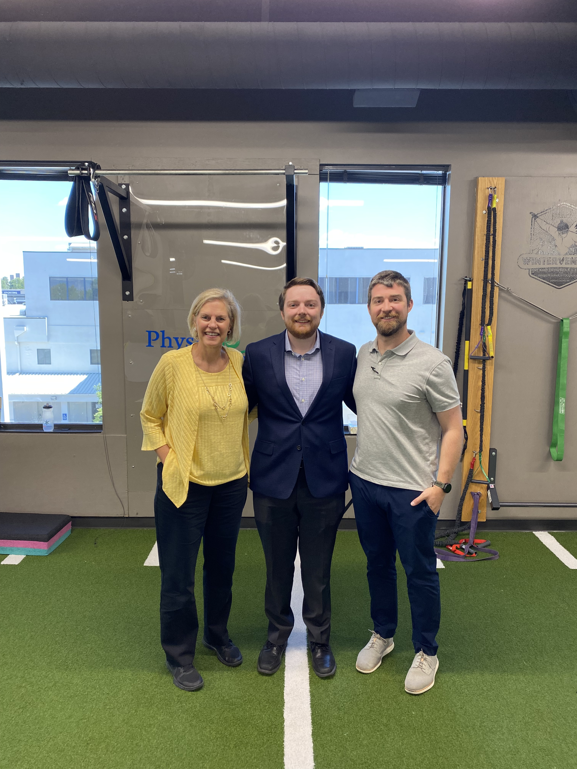
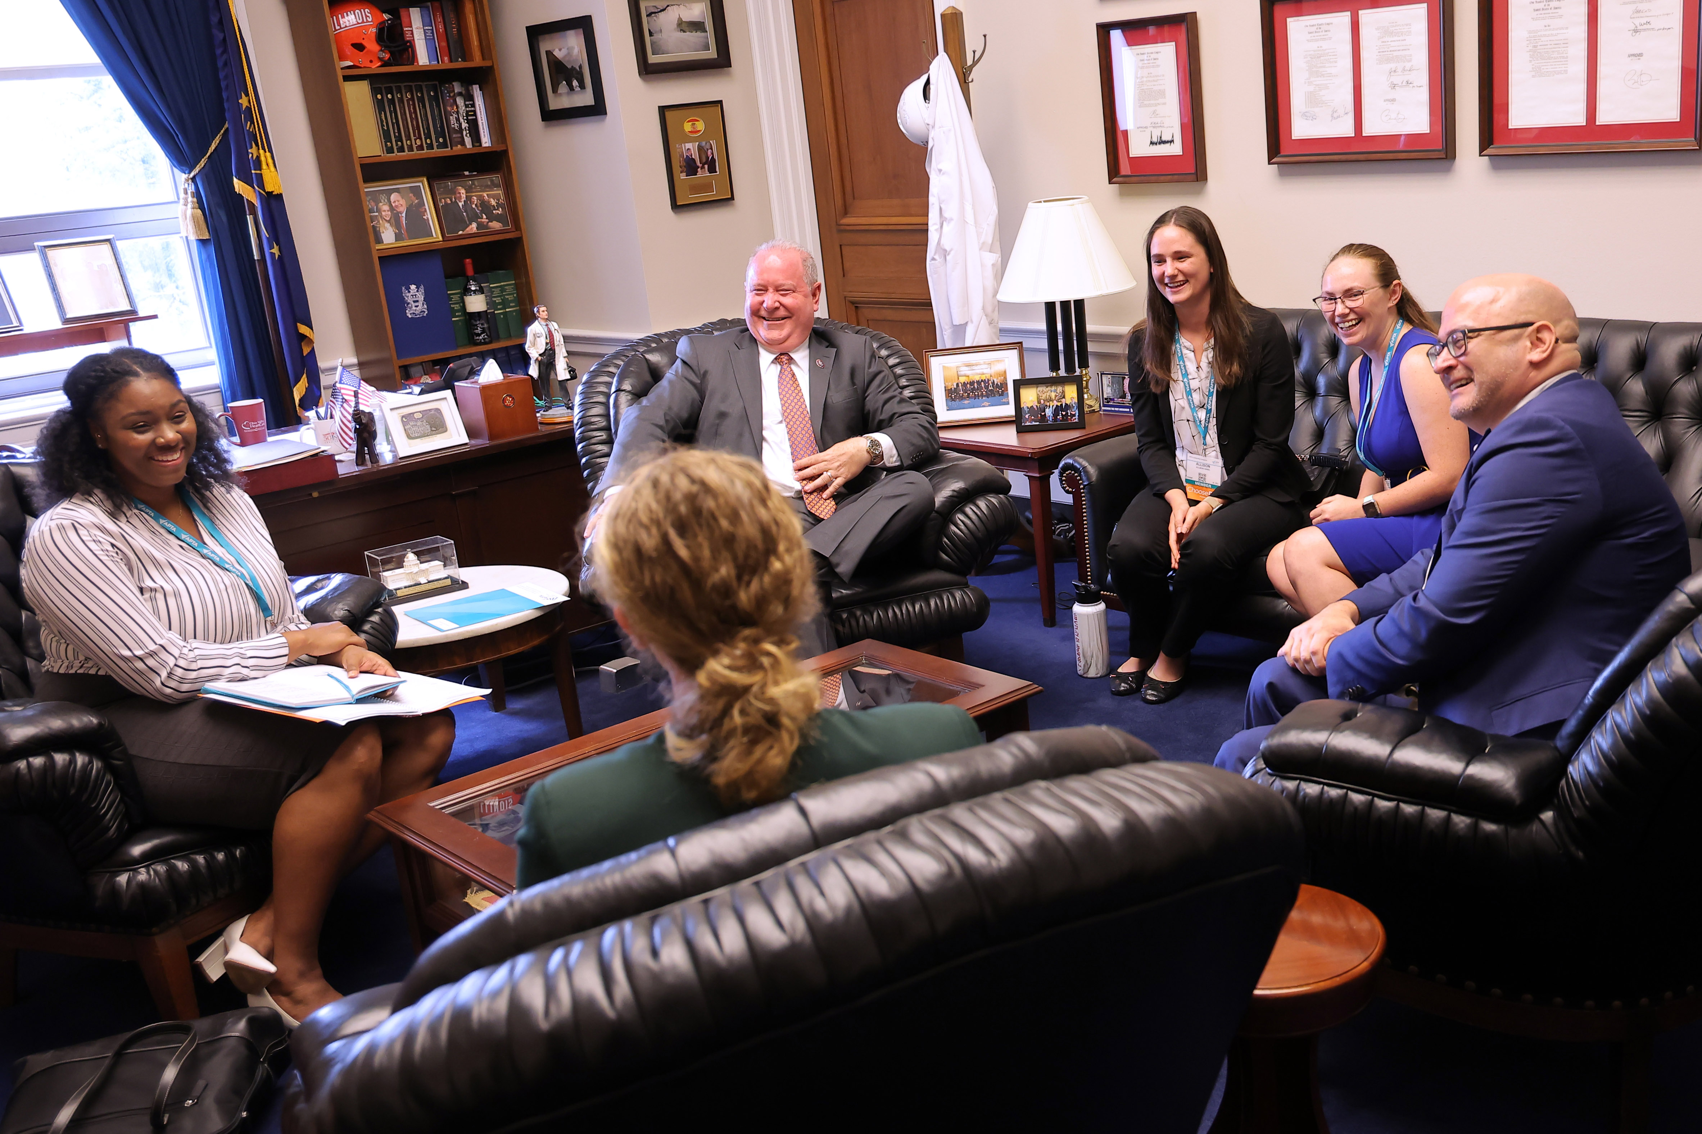
Effective Advocacy
We all have a story
Legislators want to hear from you and know how you impact your community
Educating lawmakers about physical therapy
Telling your story also shows the impact legislation will have on:
Your patients
Your community
Your clinic/business/school
Notes:
Everyone has a story. No matter who we are or what we do, we all have a story to share that can make a big impact.
Many members of Congress aren’t aware of what physical therapy is and how it helps people. It is up to us to educate legislators about PT and the impact it has on your community. Members of Congress were elected to serve the community and they want to hear from you.
Telling your story, tied to a legislative issue, can make the issue come alive and show in real ways how it will impact your patients, community, school, clinic or business. Remember, you are the expert!
TRANSITION: What opportunities do APTA members have to connect with legislators?

Slide 8
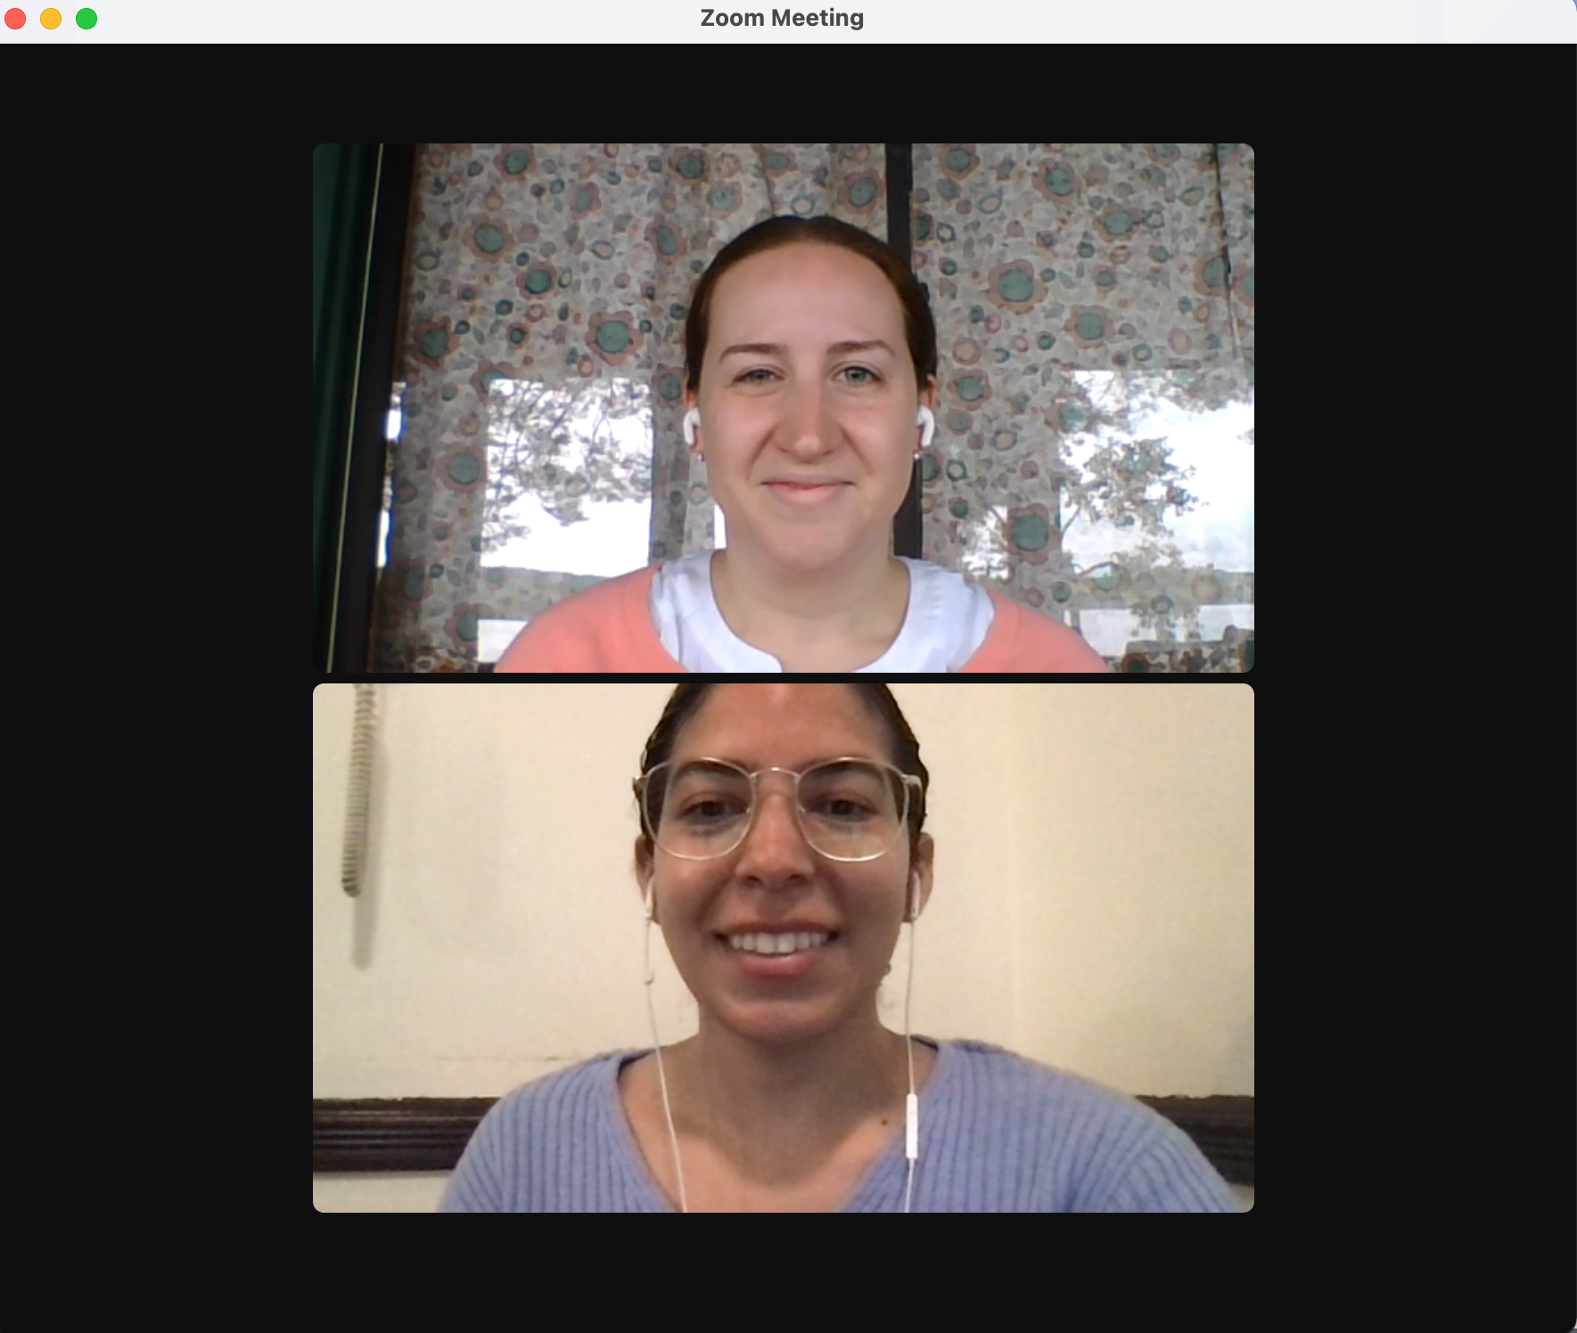
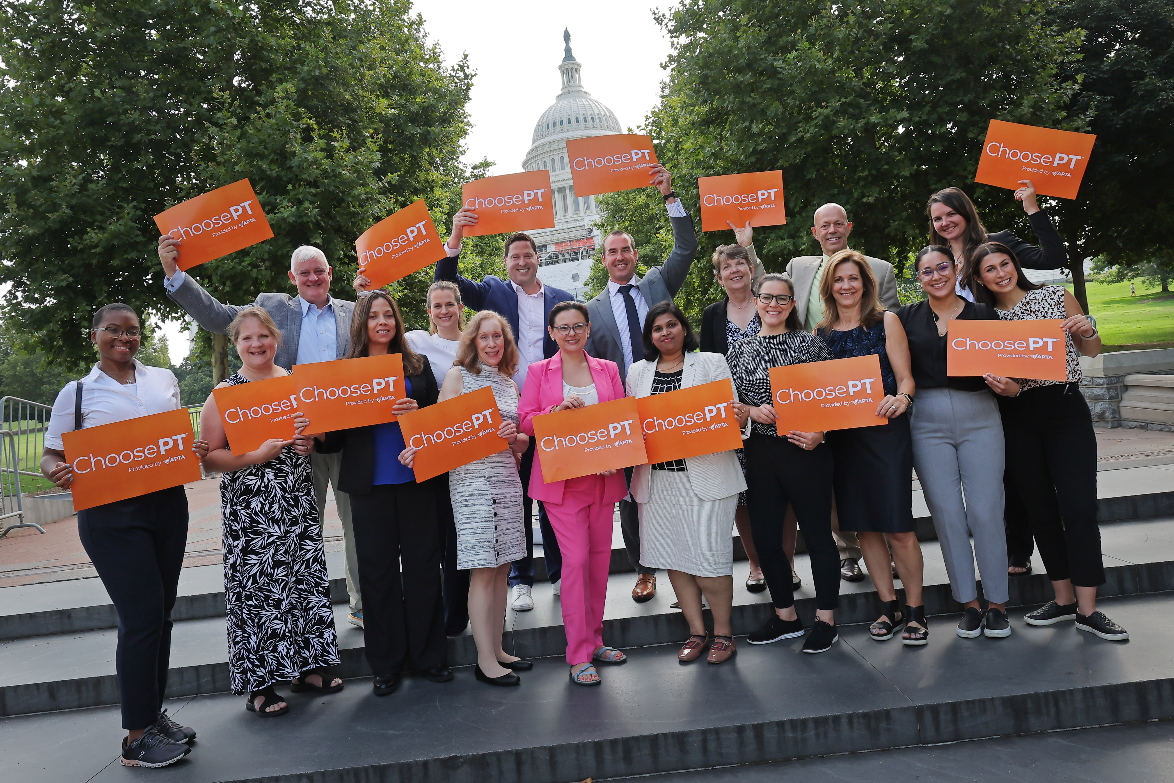
APTA Opportunities to Meet with Legislators
APTA Capitol Hill Day
April 14-16, 2024
Practice/clinic/school visits
Virtual meetings
Local events
Town halls
Fundraisers
August Recess
Notes:
There are many ways to connect with members of Congress both at home and in Washington, DC.
In 2024, APTA is hosting APTA Capitol Hill Day April 14-16 in Washington, DC. Attendees will receive advocacy training on April 15 and will be meeting with their members of Congress and staff on Capitol Hill all day on April 16. We hope to see you there!
APTA members can ask to host a member of Congress at their practice, clinic, or school, to give them a hands-on and memorable learning experience.
You can visit the legislator’s district office.
Virtual meetings are an option and an easy and convenient way to connect with legislators and staff.
You’re encouraged to sign up for your legislator’s newsletters and follow them on social media to find out when they are hosting local events or town hall meetings. PTPAC can provide opportunities to attend a local fundraiser.
August Recess is a great time to meet with a legislator since Congress adjourns for the month and goes back to work in their districts. Legislators expect to meet with their constituents during congressional recesses. Getting a physical therapy experience on their schedule is important.
TRANSITION: Now that we know how we can connect with legislators, what issues do we work on?

Slide 9
The Issues and Their Impact
Notes:
APTA works on and monitors legislation that impacts the physical therapy profession. This section will give you a brief overview of how Congress works and some of the issues that we advocate on behalf of the profession at the federal level.
How does APTA decide what issues to advocate for?
To help guide our advocacy work, APTA establishes public policy priorities every two years in conjunction with the start of a new session of Congress. APTA publishes a document called the 2023-2024 APTA Public Policy Priorities that outlines the policy priorities that Congress and regulators should address. It is created by several APTA committees with the input of APTA members. This document provides a “big picture” of the role and value of physical therapy in the health care system and how physical therapy can improve outcomes, reduce costs, and transform society.

Slide 10
Value of PT Report
Notes:
To assist in our advocacy work and show the effectiveness of physical therapy to improve society, APTA uses the findings of the recent "Economic Value of Physical Therapy in the United States," report. This is a groundbreaking APTA report that, for the first time ever, quantifies physical therapy's potential to deliver true economic value to patients, the U.S. health care system, and society as a whole.
Physical therapists and physical therapist assistants are essential to the U.S. health care system. APTA's "The Economic Value of Physical Therapy in the United States" report underscores the importance of including physical therapists and physical therapist assistants as part of multidisciplinary teams focused on improving patient outcomes and decreasing downstream costs.
The evidence presented in "The Economic Value of Physical Therapy in the United States" can support efforts by payers, governmental entities, and employers seeking to improve health outcomes, increase patient access and choice, and promote cost-effective care. Visit valueofpt.com to learn more.

Slide 11
Medicare Fee Schedule
Strengthening Medicare for Patients and Providers Act
H.R. 2474
Address meaningful, long-term reform to the Medicare Fee Schedule
Notes:
APTA, along with other impacted provider groups, are working together in a coalition to support a united policy solution to address meaningful, long-term reform to the Medicare Fee Schedule. Congress must take action to ensure the financial stability and predictability of Medicare payment, reward value-based care, safeguard timely access to high-quality care, and reduce disparities. Long-term reforms are needed to the Medicare Physician Fee Schedule to break the year-over-year cycle of cuts to providers and provide stability to both patients and providers.
Since the outpatient fee schedule is the only payment system within Medicare lacking an annual inflationary update, clinicians, many of whom are small business owners, contend with a wide range of shifting economic factors when determining their ability to provide care to Medicare beneficiaries.
Institute annual inflation-based update to the Medicare Physician Fee Schedule
This legislation is supported by over 100 health care provider organizations

Slide 12
PTA Supervision
EMPOWER Act
Enabling More of the Physical and Occupational Workforce to Engage in Rehabilitation Act
H.R. 4878/S. 2459
The current direct supervision requirement is outdated and goes back to the 1990’s.
This change will provide flexibility to the therapy workforce and ensure patient access.
Notes:
The EMPOWER Act would reduce administrative burden for small therapy businesses and provide flexibility by changing the current burdensome and outdated Medicare requirement of "direct supervision" of the physical therapist assistant requirement to "general supervision." Medicare allows for general supervision of physical therapist assistants by physical therapists in all settings — except for outpatient private practice, which requires direct supervision.

Slide 13
Telehealth
Make permanent the current temporary policy that allows PTs and PTAs to deliver and bill for services provided via telehealth under Medicare.
Expanded Telehealth Access Act
H.R. 3875/S. 2880
Notes:
The Expanded Telehealth Access Act (H.R. 3875/S. 2880) would make permanent the current temporary policy that allows physical therapists and physical therapist assistants to deliver and bill for services provided via telehealth under Medicare.
The coronavirus pandemic demonstrated how the use of telehealth in the delivery of physical therapy services can help expand access, provide convenience for Medicare patients, and promote flexibility and innovation for therapy clinics.
This bill specifically names physical therapists and physical therapist assistants, occupational therapists, occupational therapy assistants, audiologists, and speech language pathologists, and facilities that furnish outpatient therapy, as authorized providers of telehealth under Medicare.

Slide 14
Locum Tenens
Prevent Interruptions in Physical Therapy Act
H.R. 1617/S. 793
Locum tenens means “to hold the place or substitute”
Allows physical therapists temporary absences from clinic (vacation, continuing education, health care needs, etc.)
Notes:
The Prevent Interruption in Physical Therapy Act (H.R. 1617/S. 793) would allow physical therapists to use locum tenens arrangements (meaning “to hold the place of or substitute”) to bring in another licensed physical therapist to treat Medicare patients and bill Medicare through the practice provider number during temporary absences, due to illness, vacation, etc.
Existing law applies only to physical therapists in rural and underserved areas. This limitation prohibits many physical therapists in private practice from taking needed absences without interrupting patient care.
H.R. 1617/S. 793 would expand the use of locum tenens nationwide for outpatient physical therapists.

Slide 15
Pelvic Health
Optimizing Postpartum Outcomes Act
H.R. 2480
Improve awareness of and access to pelvic health physical therapy
Issue guidance, best practices, and importance or pelvic health physical therapy for postpartum individuals.
This bill exists because of APTA advocates and PTPAC!
Notes:
The Optimizing Postpartum Outcomes Act (H.R. 2480) is designed to address knowledge and access gaps for postpartum women in need of pelvic health services, in particular pelvic health physical therapy.
The bill instructs CMS to issue guidance on pelvic health services performed during the postpartum or neonatal period under Medicaid and CHIP, including best practices, financing options, and technical assistance to state agencies. The legislation orders Government Accountability Office to conduct a study on gaps in pelvic health programs.
H.R. 2480 obligates the HHS Secretary to carry out a program to educate and train health professionals on the benefits of pelvic floor physical therapy, as well as a program for postpartum women on pelvic floor physical therapy’s importance, what pelvic floor physical therapy is, and where to obtain pelvic health services.
This bill was brought about by APTA advocates!

Slide 16
National Health Service Corps/Community Health Centers
Physical Therapist Workforce and Patient Access Act
H.R. 4829
Add PTs as primary health services providers in Community Health Centers (CHCs).
Add PTs to the National Health Service Corps Loan Repayment Program
Notes:
The Physical Therapist Workforce and Patient Access Act would help provide greater patient access to rehabilitation services, including for long COVID symptoms and post-ICU recovery, and nonpharmacological treatment options in medically underserved areas of the country.
The bill would provide patients the ability to access their Medicare or Medicaid physical therapy benefit via federal community health centers, or CHCs. It would give CHCs the option to provide physical therapy care and allow the CHC to bill Medicare for PT services, similar to hospitals and skilled nursing facilities.
Currently, in a CHC setting, a patient visit to a physical therapist must be incidental to a physician visit; CHCs are not able to bill for therapy services alone.
As a result, there is very little to no physical therapist care available in CHCs.
For Medicare and Medicaid patients, this would not be a new benefit, as those programs already cover physical therapist services. Having the option to provide physical therapy services on-site and employ physical therapists, as in a hospital or nursing home setting, will help address ongoing concerns regarding access to critical health care services.
The bill would also add PTs to the list of medical providers eligible to participate in the National Health Service Corp Loan Repayment Program.
Currently, there is no physical rehabilitation care component within NHSC, a piece that would greatly complement the current program to promote health across the continuum of care.
The NHSC loan repayment program repays up to $50,000 in outstanding student loans to certain health care professionals who agree to work for at least two years in a medically underserved area.
Many NHSC providers choose to work in CHCs, and more than 85% of those same providers continue practicing in the medically underserved region long after their service.
Adding physical therapists to the NHSC and providing CHCs with greater flexibility to offer PT services will help increase access to PT care and services in the medically underserved areas.
How can you become involved in advocacy both as a student and throughout your career?

Slide 17
Getting Involved
Notes:
How can you become involved in advocacy both as a student and throughout your career?

Slide 18
Student Advocacy Programs – APTA Student Advocacy Challenge
Simple ways to get started in advocacy
Programs compete against each other by participating in advocacy activities
Submit activities for credit through APTA website or APTA
Advocacy App
HINT: Submit everything!
10 points per person for attending a National Advocacy Dinner
January 2024-December 2024
Notes:
The Student Advocacy Challenge is a competition among PT and PTA programs to participate in advocacy activities for points. On the Student Advocacy Challenge website, there is a menu of activities that you can complete for points. You can submit your activities for credit through the APTA website or APTA Advocacy App. Attendance at the event is eligible for 10 points, just be sure you are submitting it!
The Challenge runs from January 2024-end of December 2024. The winning program will not only get bragging rights, but featured on APTA’s website and will receive a virtual or in-person presentation by an APTA staff or Board member of the program’s choice.

Slide 19
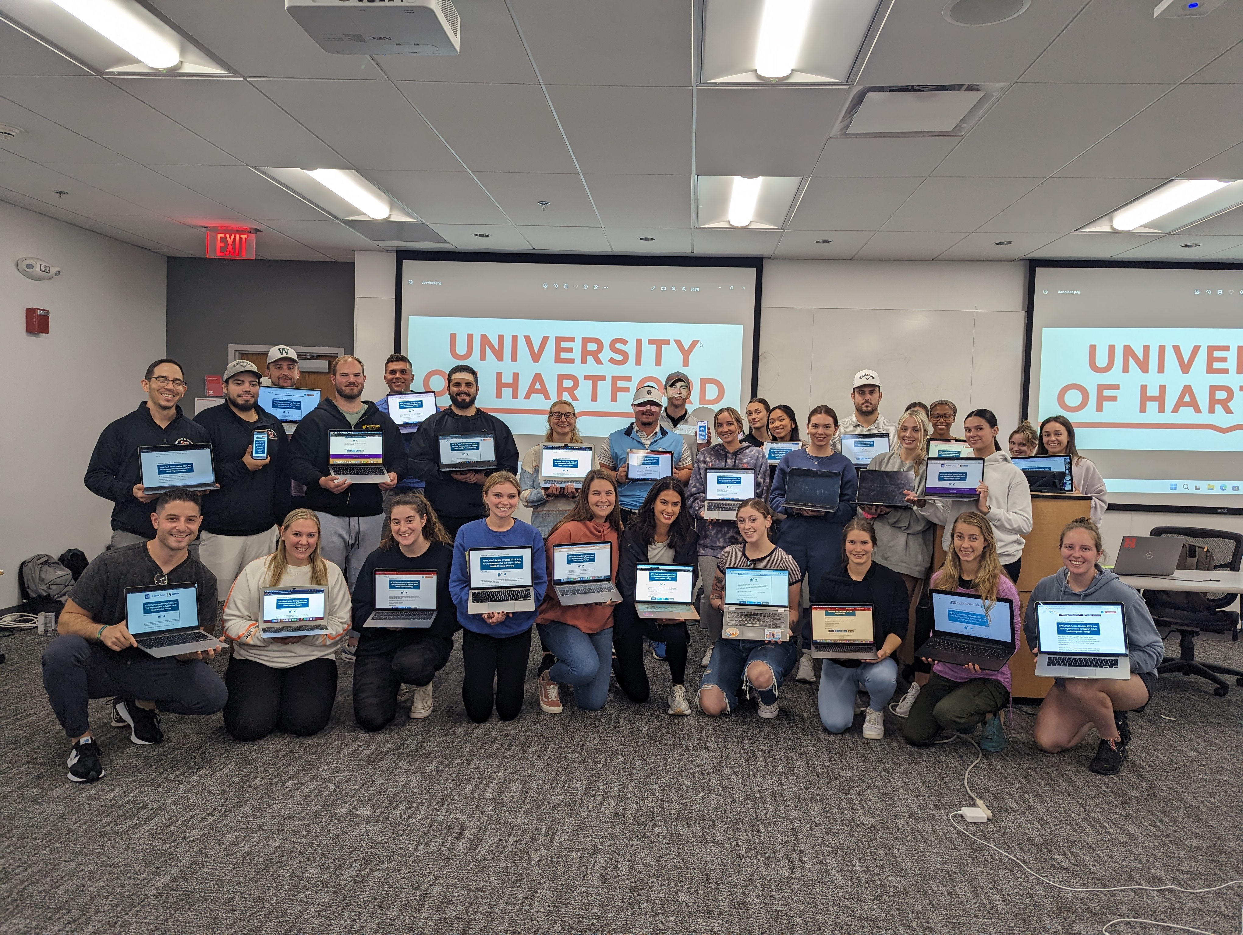
Student Advocacy Programs – APTA Flash Action Strategy
Two-day, student-led social media blitz
Focused around an issue impactful to students
Raise awareness with legislators
2023 event had 3,927 letters sent to Congress
2024 event will focus on PTPAC
Notes:
In the fall, students rally around an issue impactful to them and their future by participating in Flash Action Strategy.
Flash Action Strategy is a two-day, student-led social media blitz that includes connecting with your legislators on social media and sending letters to your members of Congress.
In the past ten years, students participating in Flash Action Strategy have been responsible for over 90,000 letters going to Congress.
It’s as easy as sending a tweet to participate, and with the collective action of all students, we can make a big difference! Social media is a powerful advocacy tool.
Most members of Congress have social media handles and have staff that monitor trending issues. You can post about physical therapy issues, include photos, and tag your legislator so they see it.
Be on the lookout for more information over the summer and the 2024 Flash Action Strategy will be sometime in September and will focus on PTPAC. More about PTPAC on the next slide!
Transition: What kind of advocacy programs are available to participate in throughout your career?

Slide 20
Advocacy Throughout Your Career
APTA Advocacy Network
Action alerts
Newsletters
Breaking news
Key Contact Program
Form and build relationships with members of Congress
Educate about physical therapy
Being active is important
Support PTPAC
APTA dues do not go toward PTPAC
Attend fundraisers
Attend advocacy events
Capitol Hill days
In-district events
Get started and stay active in advocacy!
Advocacy is a marathon, not a sprint
Notes:
The first, easiest way to get involved is to join the APTA Advocacy Network. This is APTA’s strength in numbers.
Network members receive periodic action alerts, which asks for support on an issue by sending a letter to your members of Congress.
By sending thousands of letters to Capitol Hill on a particular topic, this shows support and helps to educate and inform lawmakers.
It takes minimal time to be a part of the APTA Advocacy Network but makes a huge impact; to send a letter to Congress takes about 3 minutes. APTA Advocacy Network members also receive Information Bulletins, which are breaking news updates, and a bi-monthly newsletter.
Key Contacts are important in furthering physical therapy advocacy because they are the link between legislators and APTA, and serve as a resource on physical therapy to the member of Congress.
Key Contacts must reside or have a business in their member of Congress’ district.
There may be multiple Key Contacts in a district, and usually there are even more for Senators, who represent the whole state.
Key Contacts establish vital connections to legislators and their staff by getting to know the staff in charge of health care.
This relationship is critical because they have the ear of the legislator on health issues and often advise the legislator on whether or not to support a particular bill.
Key Contacts are also expected to set up August Recess visits with their member of Congress. In June, Key Contacts are provided talking points, information to give to legislative staff, tips, and guides to help you have a successful August Recess.
Key Contacts can also attend town hall meetings and talk about physical therapy issues. Town halls can be by phone, virtually, on social media, or in person. To find out about these events, follow your members of Congress on social media and/or sign up for their newsletter.
What tools are available for you to advocate?

Slide 21
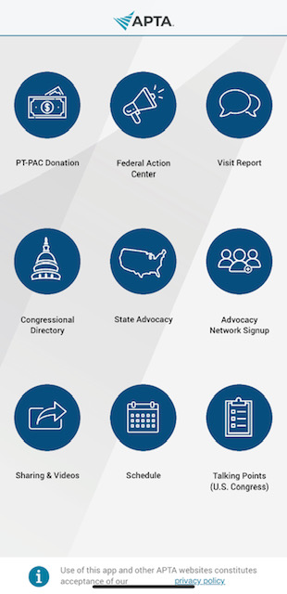
Advocacy Tools for You
Legislative Action Center
APTA members only
Patient Action Center
Public and shareable
APTA Advocacy App
Advocate in minutes from your phone
Notes:
There are several tools for you to get involved in advocacy.
APTA has two places to take action and send letters to Congress. The first is the Legislative Action Center, open to APTA members only, and the second is the public Patient Action Center. APTA Advocacy Network members are encouraged to ask fellow APTA members to join the network, and ask friends, family, colleagues, etc. to participate by sending letters of their own through the Patient Action Center.
Download the APTA Advocacy App. You can sign up for the APTA Advocacy Network there, send letters to your members of Congress, look up your members of Congress and see what bills they support, and learn about our policy issues. The app makes it easy to advocate from anywhere.
Remember, you are a vital part of APTA’s advocacy program because you’re the constituent and you’re the expert! Your unique experience in the physical therapy profession is important and members of Congress need to hear it.
Transition: How does PTPAC support your voice with legislators?

Slide 22
What is PTPAC? How does PTPAC help the profession?
PTPAC is the political action committee of APTA
Raises money from APTA members
Provides contributions to members of Congress or candidates who are friendly to the profession
Provides opportunities to speak to members of Congress
Support PTPAC
$20 Student Star program
Notes:
PTPAC is the political action committee of APTA and relies on voluntary donations from APTA members, not member dues, to have our voice heard in Congress. By attending fundraisers, APTA staff and members have important facetime with legislators to discuss issues important to the profession. How does PTPAC help the profession?
Supports PT friendly members of Congress in their election campaigns
Provides opportunities to talk to members of Congress at fundraisers about the issues of concern to the profession
Builds relationships with members of Congress and staff through fundraisers that APTA staff and members can attend
As a student, you can support PTPAC by donating $20 and becoming a Student Star. Becoming a Student Star is also eligible for points toward the Student Advocacy Challenge.
Transition: Are you ready to begin your advocacy journey? Are you ready to make an impact for the physical therapy profession?

Slide 23
Questions & Answers
advocacy@apta.org
Notes:
So how will you get started in your advocacy work? What steps can you take today to make an impact for the physical therapy profession?
If you have any questions or want to get more involved, reach out to the APTA advocacy team at advocacy@apta.org.

Slide 24
Thank You!
Notes:
Thank you for joining the 2024 APTA National Advocacy Dinner!

